Slide 1
Data ingestion
ONS Business Index

Slide 2
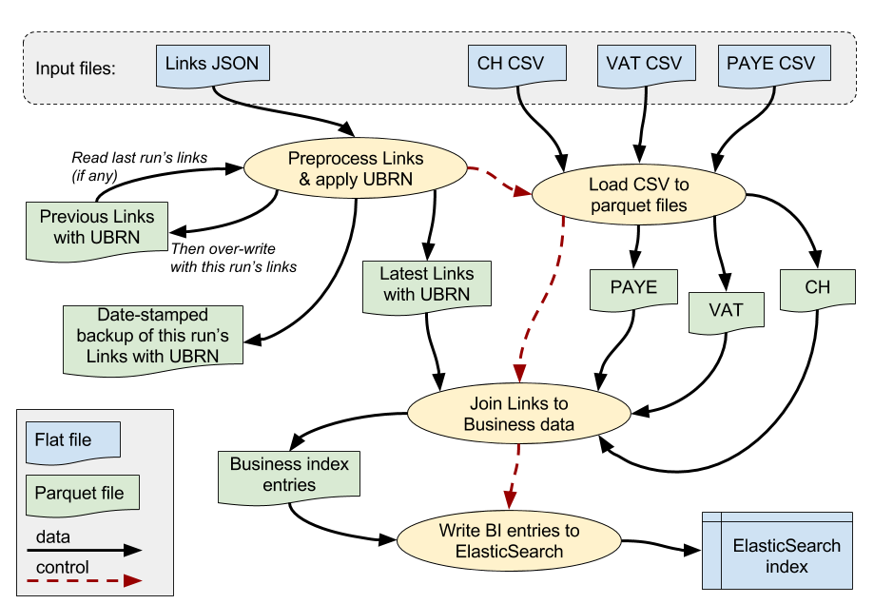
Overview of process

Slide 3
Processing
Data ingestion is implemented as a sequence of Spark processes.
Each can be executed independently via its own Oozie task.
Step 0: pre-process links (legal entity) JSON file and allocate UBRN.
Step 1: load CSV files of Companies House and HMRC (VAT, PAYE) data.
Step 2: build Business Index entries.
Step 3: upload Business Index entries to ElasticSearch index.
Configuration parameters e.g. file locations can be provided at runtime.
Default config is provided in src/main/resources/application.conf

Slide 4
Data sources
Input data comes from various sources.
These files are provided in CSV or JSON format.
They are uploaded into pre-defined locations in HDFS, prior to the BI ingestion process.
We use Apache Spark to read and process the data.
Intermediate data is stored in Parquet files.
Parquet is a file format designed for efficient processing on distributed platforms.

Slide 5
Data sources: links (legal entities)
JSON file generated by data science component outside Spark/Hadoop.
File must be uploaded into a pre-defined HDFS directory before ingestion:
/ons.gov/businessIndex/links/
Incoming data looks like this:
[{"CH": ["C1"], "VAT": ["V0"], "PAYE": ["P0"]},
{"CH": [], "VAT": ["V1"], "PAYE": ["P1"]},
{"CH": [], "VAT": ["V2"], "PAYE": []},
{"CH": [], "VAT": ["V3"], "PAYE": ["P2","P3"]},
{"CH": [], "VAT": ["V4"], "PAYE": ["P4"]},
{"CH": [], "VAT": ["V5"], "PAYE": ["P5"]}]

Slide 6
Data sources: Companies House
Companies House data is provided via monthly CSV files from CH.
http://download.companieshouse.gov.uk/en_output.html
Details of the file structure (columns etc) are available on the CH website.
There are over 40 columns in the CSV file.
Many of these may be empty for a given record.
We only use a small sub-set of the columns.
File is stored in a standard HDFS directory:
/external/companiesHouse/

Slide 7
Data sources: HMRC VAT
HMRC VAT records are currently extracted from ONS IDBR store.
The data is provided as a CSV file.
Details of the file structure (columns etc) are determined by the IDBR extraction process, which happens outside the BI data ingestion process.
There are a lot of columns in the CSV file.
Many of these may be empty for a given record.
We only use a small sub-set of the columns.
File is stored in a standard HDFS directory:
/external/hmrc/vat/

Slide 8
Data sources: HMRC PAYE
HMRC PAYE records are currently extracted from ONS IDBR store.
The data is provided as a CSV file.
Details of the file structure (columns etc) are determined by the IDBR extraction process, which happens outside the BI data ingestion process.
There are a lot of columns in the CSV file.
Many of these may be empty for a given record.
We only use a small sub-set of the columns.
File is stored in a standard HDFS directory:
/external/hmrc/paye/

Slide 9
Data: application data
We generate intermediate data files as Parquet files in HDFS.
See the application README documentation for further details.
/ons.gov | +-- businessIndex | +-- links: contains Links JSON file (see above) | +-- [dev or test or beta] | +-- WORKINGDATA: Parquet files | +-- PREVIOUS: Parquet file of Links with UBRNs from previous run | +-- 201703131145: backup of Links with UBRNs on given date/time.

Slide 10
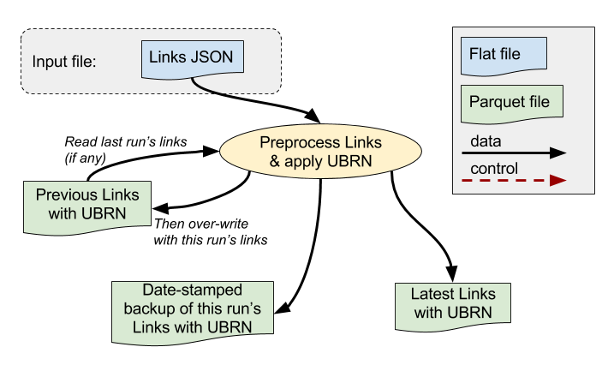
Step 0: pre-process links

Slide 11
Step 0: start Spark application
See README for more information on running application via Oozie.
There is a separate Spark app for each ingestion step, but all the apps are in the same source code file SparkApps.scala.
object PreprocessLinksApp extends DataloadApp {
// Load Links JSON, preprocess data (apply UBRN etc), write to Parquet.
val sparkConf = new SparkConf()
.setAppName("ONS BI Dataload: Apply UBRN rules to Link data")
val ctxMgr = new ContextMgr(sparkConf)
val lpp = new LinksPreprocessor(ctxMgr)
lpp.loadAndPreprocessLinks(appConfig)
}

Slide 12
Step 0: read JSON file from HDFS
Spark SQLContext allows you to read JSON straight into a DataFrame:
class LinkJsonReader (ctxMgr: ContextMgr) extends BIDataReader {
val sqlContext = ctxMgr.sqlContext
def readFromSourceFile(srcFilePath: String): DataFrame = {
sqlContext.read.json(srcFilePath)
}
}
But JSON processing requires a lot of RAM, so this can be quite slow.
We store intermediate data as Parquet, which performs much better.

Slide 13
Step 0: UBRN allocation
Step 0 is almost all about UBRN allocation i.e. seeing if a new legal entity matches one from the previous load, allowing us to re-use its UBRN.
This is a demanding process that runs via the LinksPreprocessor class.
The matching rules are implemented via a series of Spark SQL queries in the LinkMatcher class.
Each query tries to identify a sub-set of the data that matches according to a given rule, then excludes the matched records from the data processed by the next rule’s query.
Aim is to reduce number of records we have to check at each stage.

Slide 14
Step 0: UBRN allocation
IF (old CH IS NOT NULL AND new CH IS NOT NULL) AND (old CH = new.CH) THEN use old UBRN for new Link record ELSIF (old CH IS NULL AND new CH IS NULL) AND (old contents = new contents) THEN use old UBRN for new Link record ELSIF (old VAT ref = new VAT ref) THEN /* implemented in branch only! */ use old UBRN for new Link record ELSIF (old PAYE ref = new PAYE ref) THEN use old UBRN for new Link record ELSE allocate new UBRN END IF

Slide 15
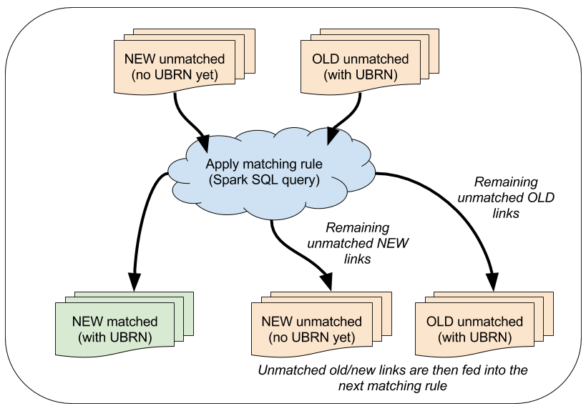
Step 0: UBRN allocation

Slide 16
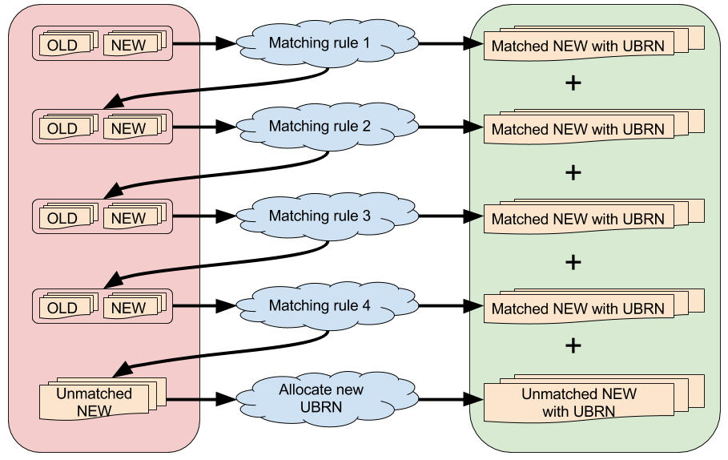
Step 0: UBRN allocation

Slide 17
Step 0: UBRN allocation - example
def applyAllMatchingRules(newLinks: DataFrame, oldLinks: DataFrame): (DataFrame, DataFrame) = {
// Each rule eliminates matching records from the set of links we still have to match,
// so each step should have a smaller search space.
// Cache intermediate sets so we don't have to keep re-materialising them.
// Get CH matches where CH is present in both sets
val chResults = getChMatches(oldLinks, newLinks)
// Cache results as they will be re-used below
chResults.unmatchedOldLinks.cache()
chResults.unmatchedNewLinks.cache()
chResults.matched.cache()
// ... go on to apply next rule etc ...

Slide 18
Step 0: UBRN allocation - example
def getChMatches(oldLinks: DataFrame, newLinks: DataFrame): LinkMatchResults = {
val matchQuery =
"""
SELECT p.UBRN AS UBRN,c.GID, c.CH, c.VAT, c.PAYE
FROM old_links AS p
INNER JOIN new_links AS c ON (p.CH = c.CH)
WHERE p.CH IS NOT NULL
AND c.CH IS NOT NULL
AND p.CH[0] IS NOT NULL
AND c.CH[0] IS NOT NULL
""".stripMargin
applySqlRule(matchQuery, oldLinks, newLinks)
}

Slide 19
Step 0: UBRN allocation - example
def applySqlRule(matchQuery: String, oldLinks: DataFrame, newLinks: DataFrame) = {
// Short-circuit to skip query if old frame is empty, as no matches will exist
val matched: DataFrame =
if (isDfEmpty(oldLinks)) // returns an empty DF with expected structure
BiSparkDataFrames.emptyMatchedLinkWithUbrnGidDf(sc, sqlContext)
else {
// Set these each time
oldLinks.registerTempTable("old_links")
newLinks.registerTempTable("new_links")
// Execute SQL rule and get matched records
sqlContext.sql(matchQuery)
}
// Remove matched data from sets of data to be processed
excludeMatches(oldLinks, newLinks, matched)
}

Slide 20
Step 0: UBRN allocation - example
def excludeMatches(oldLinks: DataFrame, newLinks: DataFrame, matched: DataFrame): LinkMatchResults
= {// Exclude matched UBRNs from oldLinks, and exclude matched GIDs from newLinks.
// Return the unmatched sub-sets for old and new, plus matched set.
// If no data was matched, just return the original old/new sub-sets
val results: LinkMatchResults =
if (isDfEmpty(matched)) LinkMatchResults(oldLinks, newLinks, matched)
else {
val unmatchedOldUbrns = oldLinks.select("UBRN").except(matched.select("UBRN"))
val unmatchedNewGids = newLinks.select("GID").except(matched.select("GID"))
val unmatchedOldLinks = unmatchedOldUbrns.join(oldLinks, usingColumn = "UBRN")
.select("UBRN", "CH", "VAT", "PAYE")
val unmatchedNewLinks = unmatchedNewGids.join(newLinks, usingColumn = "GID")
.select("GID", "CH", "VAT", "PAYE")
LinkMatchResults(unmatchedOldLinks, unmatchedNewLinks, matched)
}
results
}

Slide 21
Step 0: UBRN allocation
The very first time we load a “links” file (legal entities), we can just assign them all new UBRNs as there is no previous month’s file.
We store the current month’s output with its UBRNs under the PREVIOUS directory in our working folder, ready for the next month’s load.
Next month, we read a fresh file of links and compare them with those in the previous month’s file to see if we can re-use their UBRNs.
The end result is a fresh file of links with UBRNs, that we also store under PREVIOUS, ready for the next month.
So each month we create a new “previous” file, which will be used for the following month’s UBRN allocation.

Slide 22
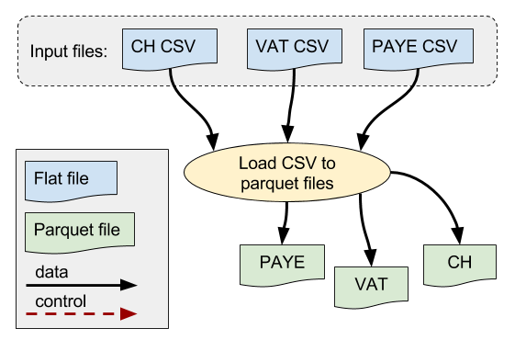
Step 1: load CSV files to Parquet

Slide 23
Step 1: load CSV files to Parquet
This step is relatively simple, as we just load the 3 sets of CSV source data into Spark as DataFrames then store them as Parquet files.
Spark 1.6 does not include the Spark CSV package for reading CSV files, so we have to supply this to the Oozie/Spark job via JARs at runtime.
Spark CSV package is integrated into Spark 2.0 by default.
We convert CSV column names to SQL-compliant format e.g. removing spaces, dots etc, so that we will be able to read the Parquet data easily using Spark SQL later on.
See application README and source file CsvReaders.scala for details.

Slide 24
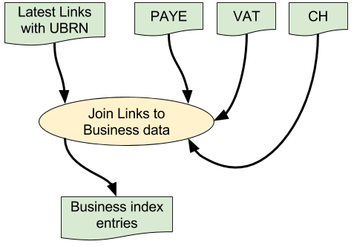
Step 2: build Business Index entries

Slide 25
Step 2: build Business Index entries
The basic logic is simple here:
We receive the incoming links (legal entities) which contain only IDs and UBRN.
We join these to the corresponding records in the Companies House, VAT and PAYE files.
We extract the data fields we want to include in the Business index entry for each legal entity.
Some of these fields need to be converted e.g. from values to bands.
We write the resulting Business Index records to a Parquet file.

Slide 26
Step 2: build Business Index entries
The problem is implementing this process effectively on a distributed processing platform like Apache Spark.
This requires us to think about the data structures we use during processing so that we can use Spark’s built-in functions like “join” and “groupBy”, instead of trying to implement our own less efficient versions.
This means the Scala code uses various temporary data structures, mostly RDDs and case classes, as it performs successive transformations on the data.
We then write the BI entries out from a DataFrame to a Parquet file.

Slide 27
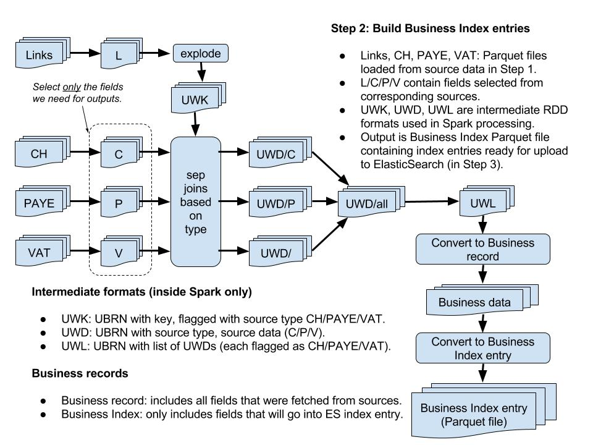
Step 2: build Business Index entries

Slide 28
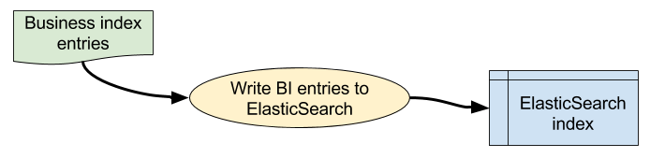
Step 3: upload BI entries to ElasticSearch

Slide 29
Step 3: upload BI entries to ElasticSearch
We read the BI Parquet file that we created in step 2 into a Spark DataFrame.
The ElasticSearch Spark driver extends the standard DataFrame with methods to write to ElasticSearch.
We then write the BI DataFrame to the required ES index.
The index name and server can be specified at runtime.
The empty ES index must be created separately beforehand, as the ES Spark driver does not allow us to create the index with the required additional parameters.

Slide 30
Notes: Scala stuff - Options
We use a lot of Options in this code, because it is possible for almost any data item to be empty.
Options allow you to handle empty (null) values without errors.
An Option is like a box that contains either None or Some(object).
You can process them with map() and flatMap() etc, without having to keep checking if there is anything in there.
You only need to worry about the Option being None when you finally get the actual value out.
Then you can use getOrElse(...) to specify a default value if there’s nothing in there.

Slide 31
Notes: Scala stuff - very basic sealed traits
Traits are a bit like Java interfaces i.e. they allow you to tag an object as having a particular type, without specifying the class.
Sealed traits can be used like Java enumerations to specify a fixed set of values available under the trait (cf. days of the week).
trait BIDataSource
sealed trait BusinessDataSource extends BIDataSource
case object CH extends BusinessDataSource
case object VAT extends BusinessDataSource
case object PAYE extends BusinessDataSource
sealed trait LinksData extends BIDataSource
case object LINKS extends LinksData

Slide 32
Notes: Spark SQL
Spark operates on distributed data e.g. in HDFS.
It uses special data structures such as RDDs and DataFrames that look a lot like Collections (Lists etc).
RDDs work on pretty much any data, while DataFrames are for structured data and support the Spark SQL API.
DataFrames can be manipulated as “temporary tables” via SQL.
We have used a fair amount of SQL here, because it makes it clearer what we are trying to achieve, e.g. matching links for UBRN allocation.
However, these queries may cause errors e.g. if the incoming data formats change.

Slide 33
Notes: Spark SQL DataFrame schemas
DataFrames have a schema and you may need to provide this explicitly.
For example, to create an empty DF with a specific schema:
// DataFrame schema for legal unit ("link") with UBRN
val linkWithUbrnSchema = StructType(Seq(
StructField("UBRN", LongType, true),
StructField("CH", ArrayType(StringType), true),
StructField("VAT", ArrayType(StringType), true),
StructField("PAYE", ArrayType(StringType), true)
))
def emptyLinkWithUbrnDf(sc: SparkContext,
sqlContext: SQLContext):DataFrame =
sqlContext.createDataFrame(sc.emptyRDD[Row], linkWithUbrnSchema)

Slide 34
Notes: Spark SQLContext & HiveContext
Spark SQLContext provides SQL functionality for DataFrames.
By default, Apache Spark 1.6 uses a basic SQLContext object.
Cloudera provides an instance of this which we can access in our code.
However, we have to use more advanced SQL features, such as window queries for the UBRN allocation, which are only available via the HiveContext object.
The HiveContext is created differently, and requires extra configuration at the Cloudera level.
Spark 2.0+ provides a different and easier mechanism for accessing the HiveContext, so hopefully this will be easier in future.

Slide 35
That’s all, folks!

